Slide 1

Google Play App Market Strategy
Transforming Google Play Store Dataset Records into Real-Time Visual Insights via Google Data Studio (Looker Studio) Custom Dashboards

Slide 2

Executive Overview
An end-to-end Looker Studio reporting pipeline analyzing category performance, price sensitivity, app payload size, and user review velocity.

Slide 3

Market Landscape Snapshot
10.8K
Freemium Growth Engine
Google Data Studio aggregations demonstrate that 92.6% of Play Store apps are Free, accounting for over 98.4% of total download volume.
Upfront payment models create heavy install friction. Long-term app monetization depends on freemium upsells, recurring subscriptions, and targeted ad placements.
Analyzed App Profiles

Slide 4
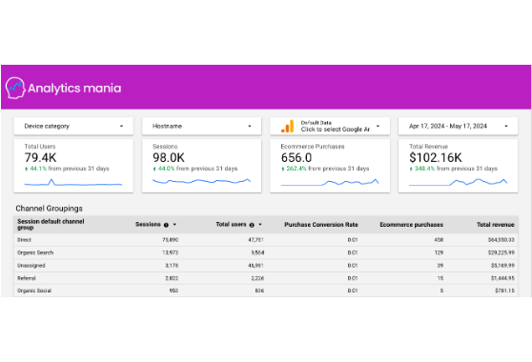
GDS / Looker Studio Architecture
Data Source Connector: Native integration connecting Google Sheets/BigQuery CSV payloads directly into Looker Studio schema.
Calculated Fields: Constructed custom metrics using CASE WHEN logic for size tiering, rating bins, and estimated total revenue.
Interactive Controls: Deployed drop-down category filters, metric sliders, and scorecards for dynamic executive exploration.

Slide 5

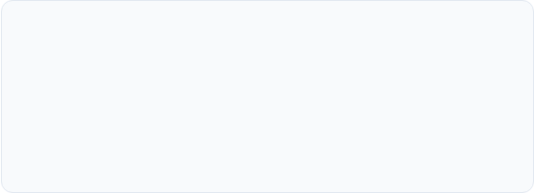
Category Opportunity Matrix
1. Red Oceans (High Saturation)
2. Blue Oceans (High Intent)
Family & Game categories represent ~35% of total store app listings (~3,800 apps). Saturated markets require steep User Acquisition (UA) ad spend to gain organic visibility.
Finance, Health & Fitness, and Productivity show exceptional install-per-app ratios. Users demonstrate stronger intent and higher lifetime value (LTV) in utility niches.

Slide 6
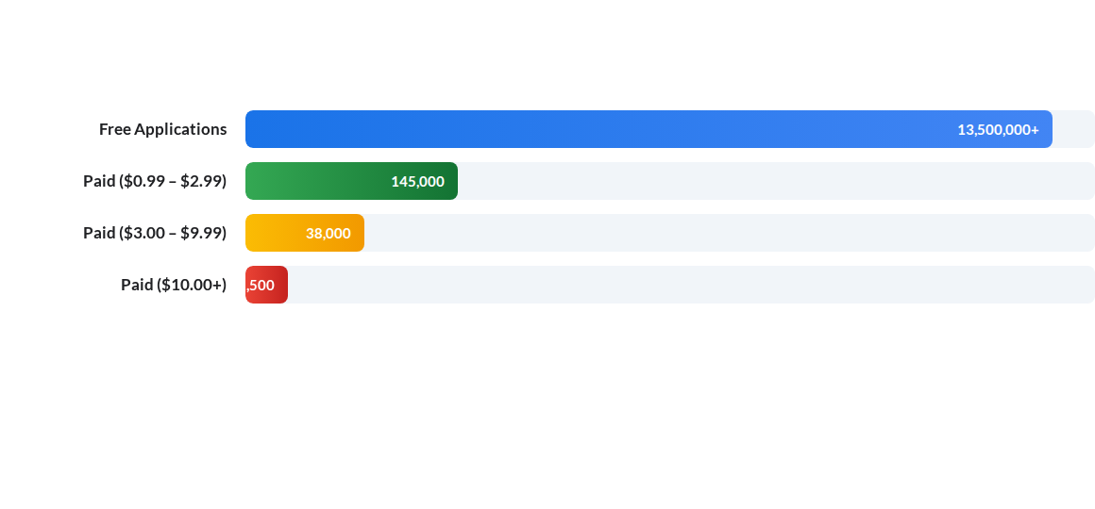
Downloads Across Price Tiers
GDS Interactive Bar Chart: Free apps generate 90x more install volume than $0.99 apps. Mobile roadmap must prioritize zero-friction download funnels paired with dynamic in-app upgrades.

Slide 7
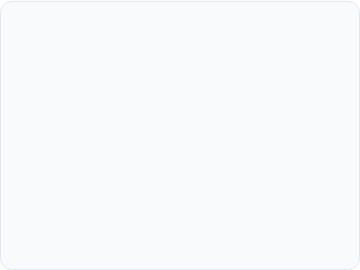
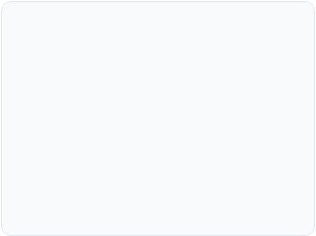
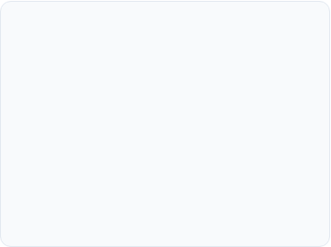



Core App Success Drivers
Rating Benchmark (4.2+)
Size Sensitivity (< 30MB)
Monthly Update Rhythm
Apps rated above 4.2 capture 85%+ of total store downloads. Falling below 4.0 cuts conversion rate by over 50% on search impressions.
App binary sizes under 30MB achieve 2.4x higher conversion in emerging markets where storage and data caps remain strict.
Apps updated at least monthly show 38% higher 90-day retention, benefiting from active algorithmic boosting in store rankings.

Slide 8
Category Performance Matrix
Category Sector | Avg App Size | Avg Rating | Monetization Model | Looker Studio Score
Game | 64.3 MB | 4.28 / 5.0 | In-App Purchases (IAP) + Ads
Finance | 28.1 MB | 4.13 / 5.0 | Freemium Subscriptions
Health & Fitness | 31.5 MB | 4.25 / 5.0 | Monthly Tiered Plans
Tools & Utilities | 18.2 MB | 4.04 / 5.0 | In-App Ad Network
Family & Casual | 42.7 MB | 4.19 / 5.0 | Hybrid Ad & Micro-IAP

Slide 9
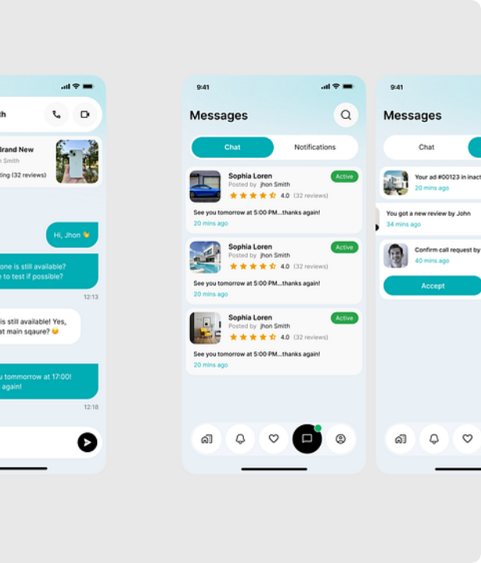
User Review Sentiment
Social Proof Acceleration
Review velocity directly dictates algorithm ranking on Google Play search. Unlocking 10,000+ positive reviews creates a self-sustaining viral organic acquisition loop.
Deploying smart in-app rating prompts during moments of delight (e.g., milestone completion) increases positive review conversion by 3x.

Slide 10
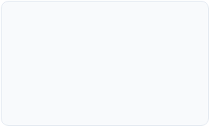
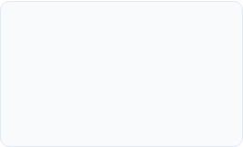

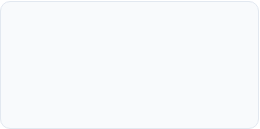
Product Growth Roadmap
Q2 - Interactive Controls
Q4 - Embedded Analytics
Deploy custom calculated fields, dynamic metric sliders, and category drop-down filters.
Embed live Looker Studio dashboards into internal team portals for real-time tracking.
Q1 - Pipeline Setup
Q3 - Automated Alerts
Connect Google Play store CSV data into Google Data Studio via Sheets/BigQuery connectors.
Configure automated scheduled email reports for rating drops and sentiment shifts.

Slide 11
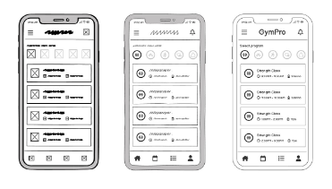
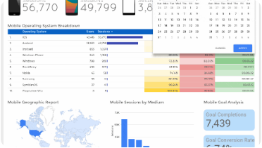
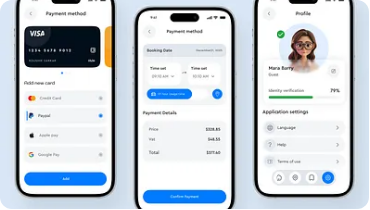
Strategic Growth Pillars
Lean UX & Payload Size
Looker Studio Monitoring
Freemium Conversion
Keep binary size under 30MB and streamline initial onboarding to prevent immediate user uninstalls.
Track real-time KPI alerts for rating drops, review sentiment shifts, and category trend changes.
Maximize top-of-funnel reach with free downloads while driving high LTV via tiered subscriptions.

